Slide 1
Center for Undervisningsmidler

Slide 2
Speakers Professor Daniel N. Stern, Geneva Professor Stein Bråten, Oslo
Dynamics of Lived Experience and Participant Learning –
Implications for Theory and Pedagogy
Center for Undervisningsmidler

Slide 3
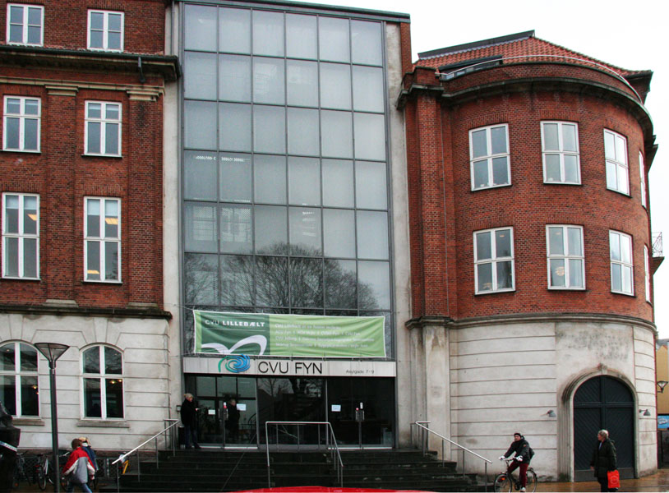
Superkonference
på
University College Lillebaelt,
Asylgade 7-9 Odense C, Denmark
d. 3. April 2008
Center for Undervisningsmidler

Slide 4
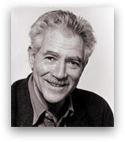
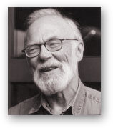
Daniel Stern
Stein Bråten
Professor of Psychology at the University of Geneva and adjunct professor of Psychiatry at Cornell University Medical Centre – New York Hospital
Professor Emeritus, Dr. philos in psychology at the University of Oslo.
Head of Theory Forum on Preverbal Intersubjectivity.
Center for Undervisningsmidler

Slide 5
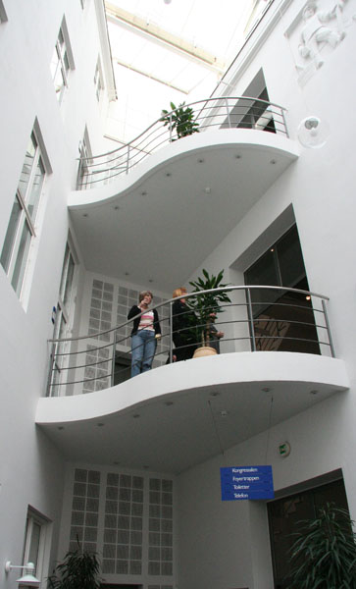
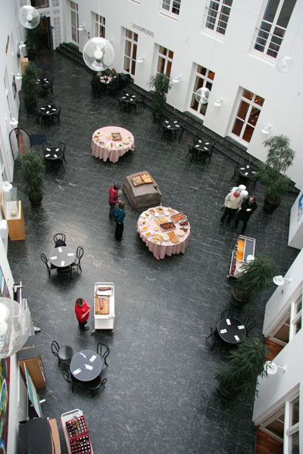
Konferencen holdes i Asylgade 7-9
Center for Undervisningsmidler

Slide 6
Målgruppe:
Psykologer, universitetsansatte og studerende, professionsskoleundervisere og studerende, skoleledere, lærere, pædagoger, sundhedspersonale, konsulenter og andre interesserede.
Center for Undervisningsmidler

Slide 7
www.kommunikation-relationer.dk
Læs mere
Center for Undervisningsmidler

